Slide 1
WEATHER DATA ANALYSIS
USING GOOGLE COLAB (PYTHON LANGUAGE)
BY AISHWARYA KADAM

Slide 2
Steps :
Import data
Data Analysing
Data Visualization
Answer the Questions

Slide 3
Description:
The Weather Dataset is a time-series dataset with per-hour information about the weather condition at a particular location. It records Temperature, dew Point temperature, Relative humidity, Wind speed, Visibility, Pressure and conditions.
This Dataset available as a csv file. We are going to analyze this dataset using Pandas data frame.

Slide 4
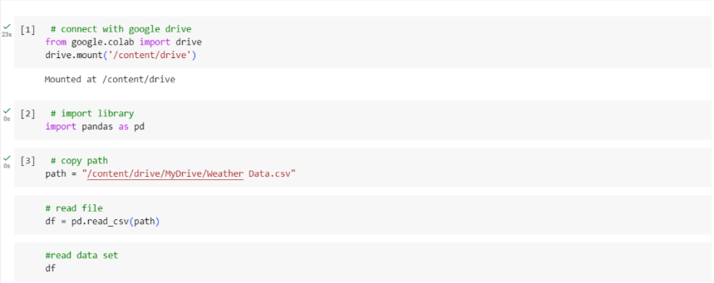
Google Colab is a cloud-based platform that provides a free Jupyter notebook environment for running Python code. It allows users to write, execute, and share code, making it convenient for collaborative coding, data analysis, and machine learning tasks.

Slide 5
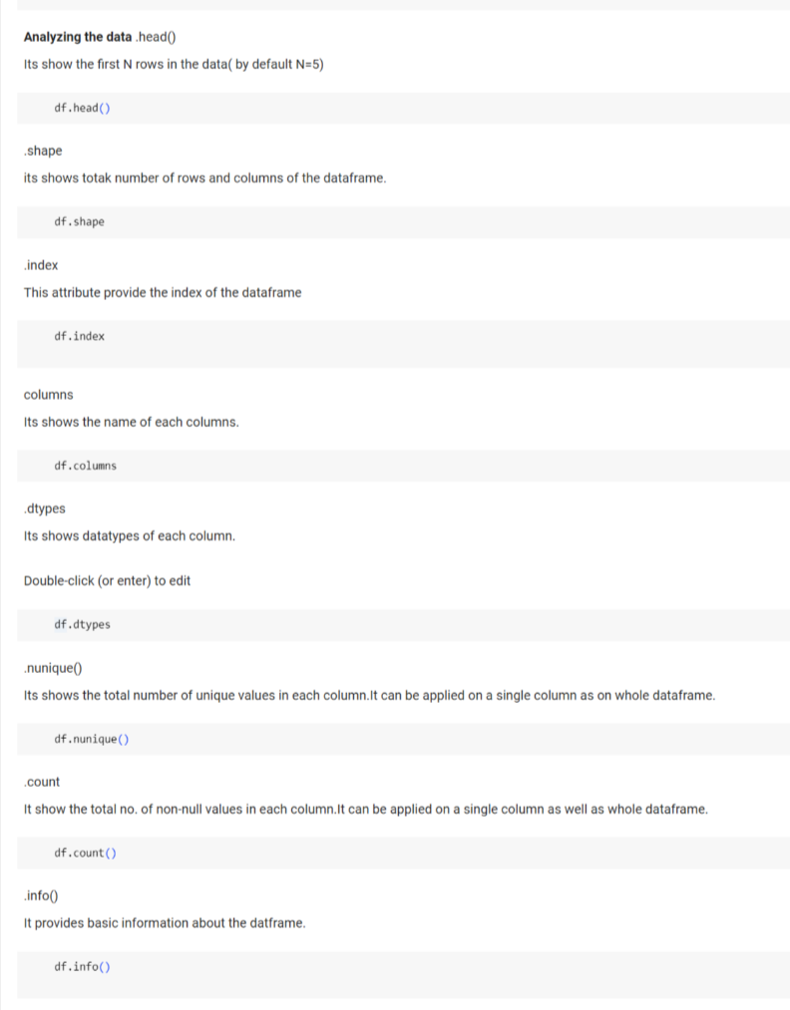

Slide 6
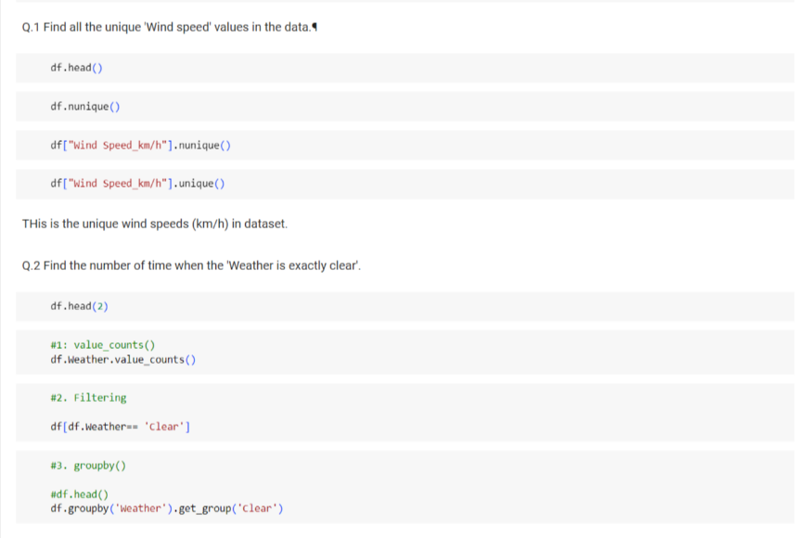

Slide 7
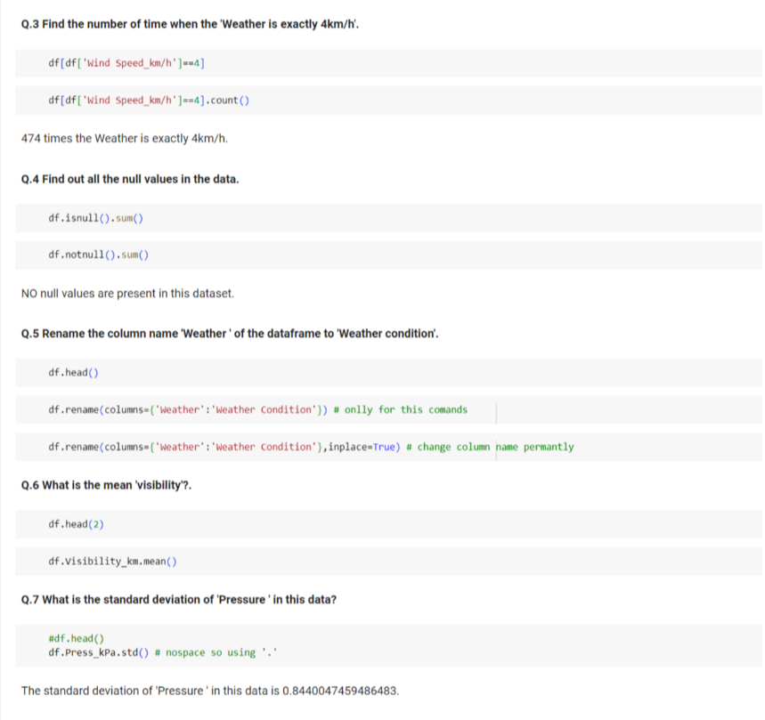

Slide 8
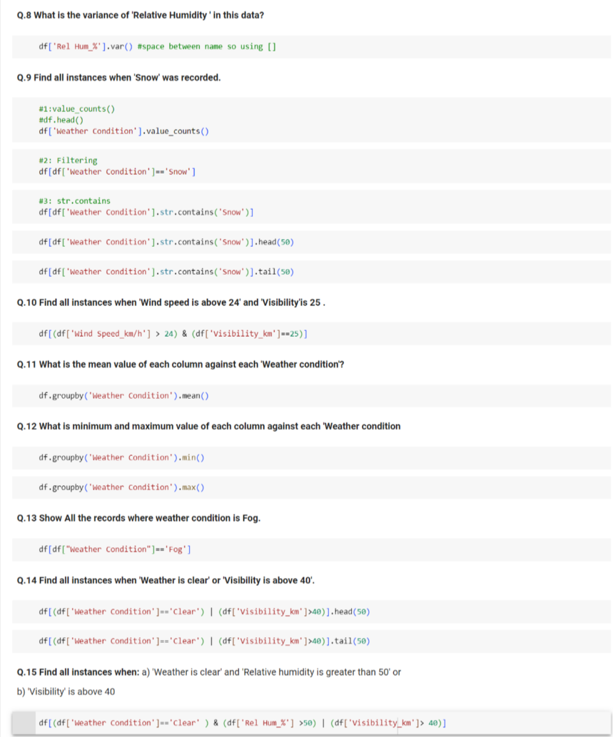

Slide 9
Thank You..

